Slide 1
HCC optimization in Ceph Messenger
Cheng, Yingxin from SSE – CSE - Storage

Slide 2
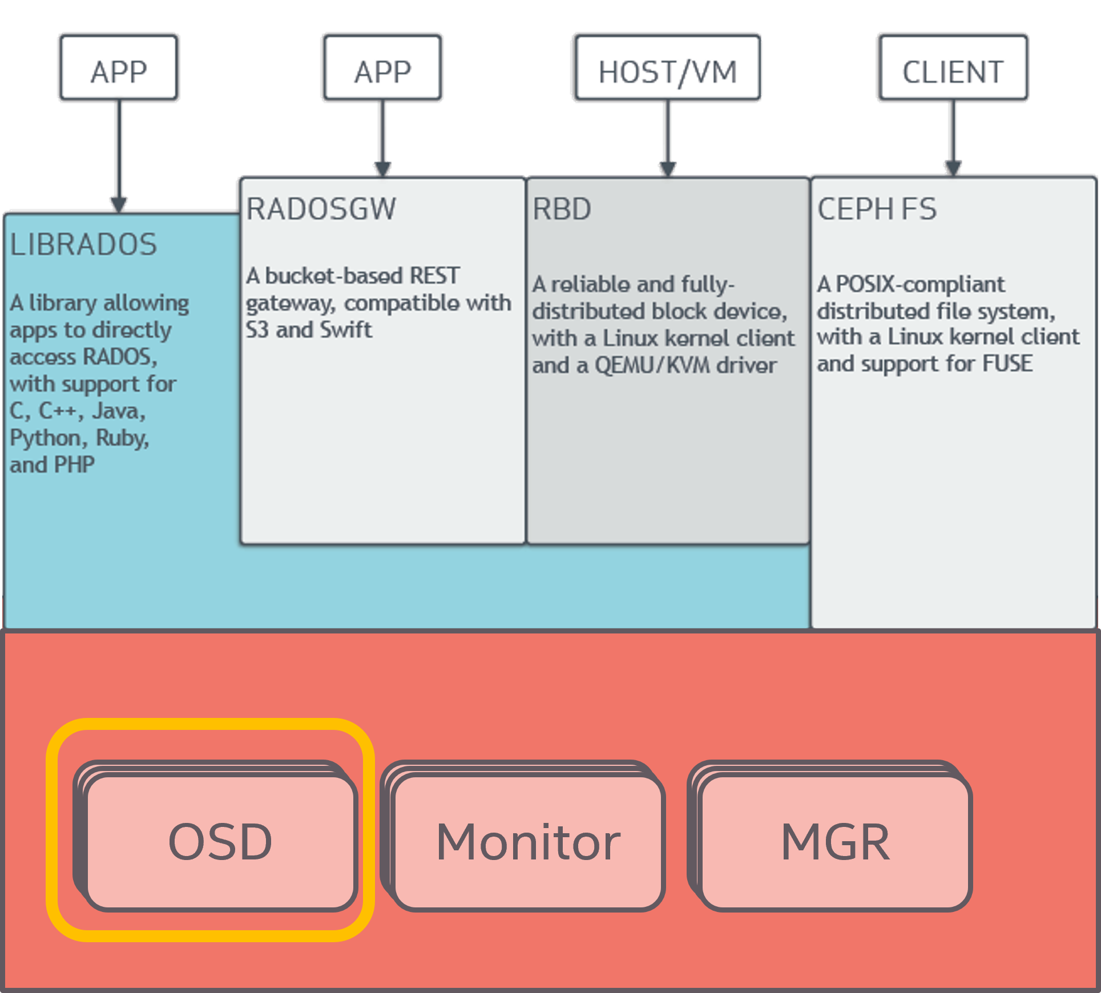
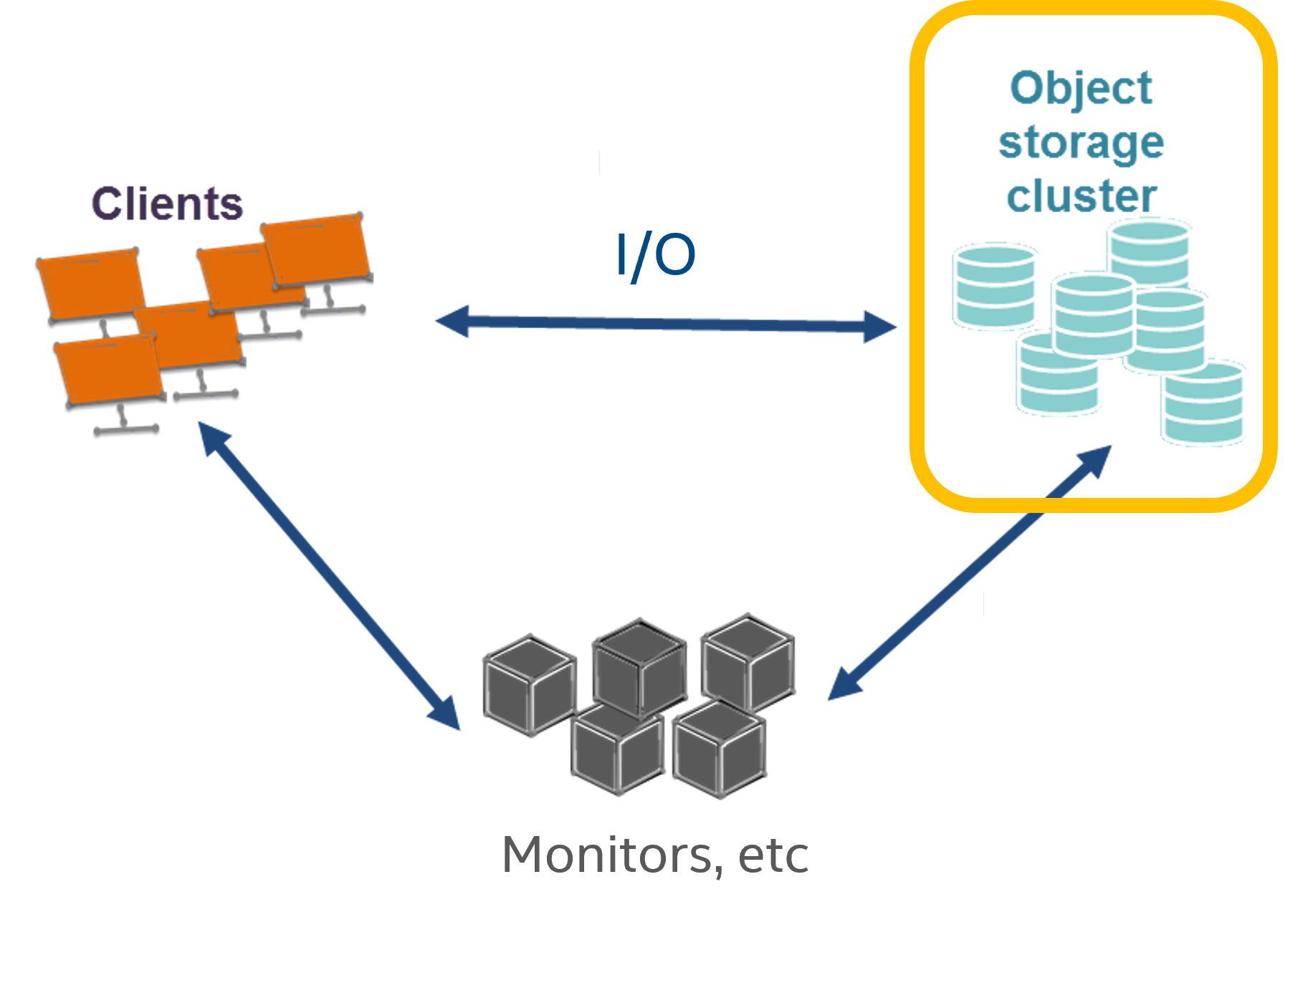
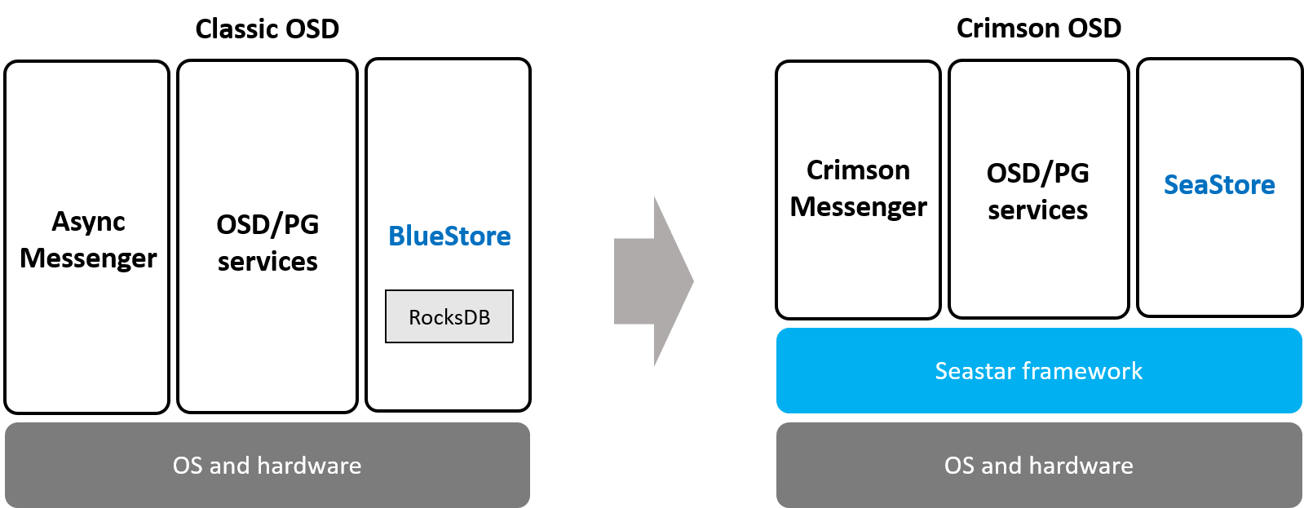
Background
Customers
Telco (AT&T, China Mobile, etc)
CSP (Ebay, SalesForce, etc)
Enterprise (IBM, H3C, etc)
OEM/ODM (Dell, Inspur, etc)
$500m+ Xeon sales (2020)
Ceph Community
2nd Contributor after Redhat
Ceph Leadership Team
Ceph Component Lead (SeaStore)
Ceph, OSD, Messenger
The Crimson Project

Slide 3
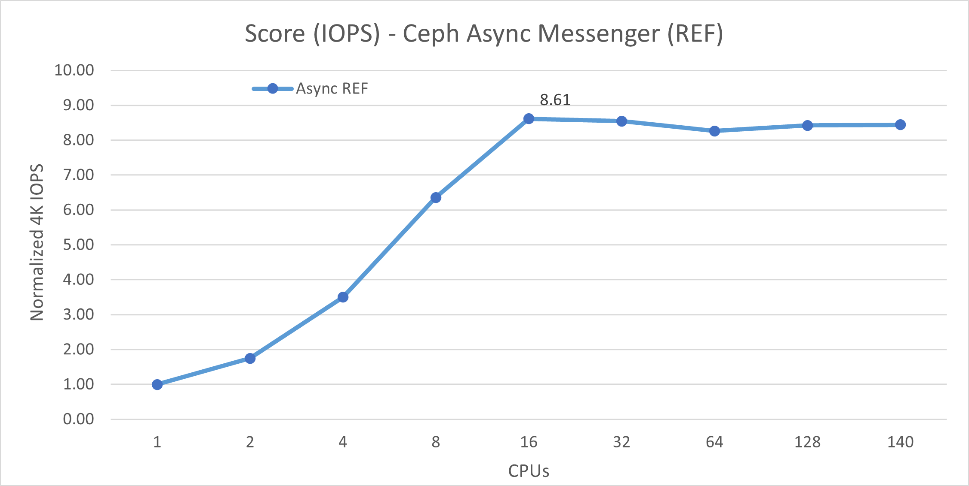
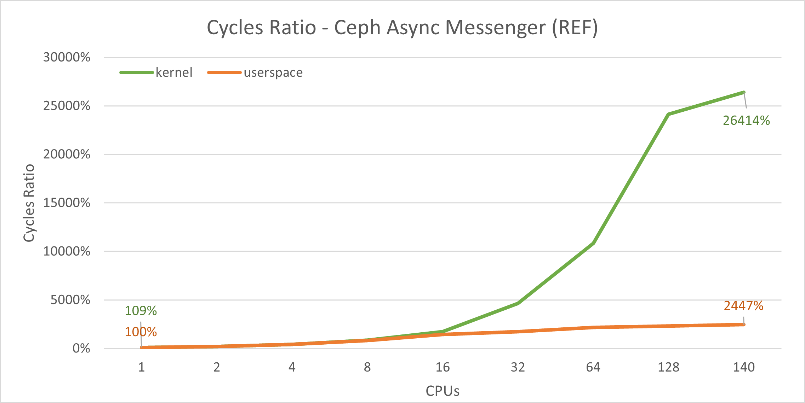
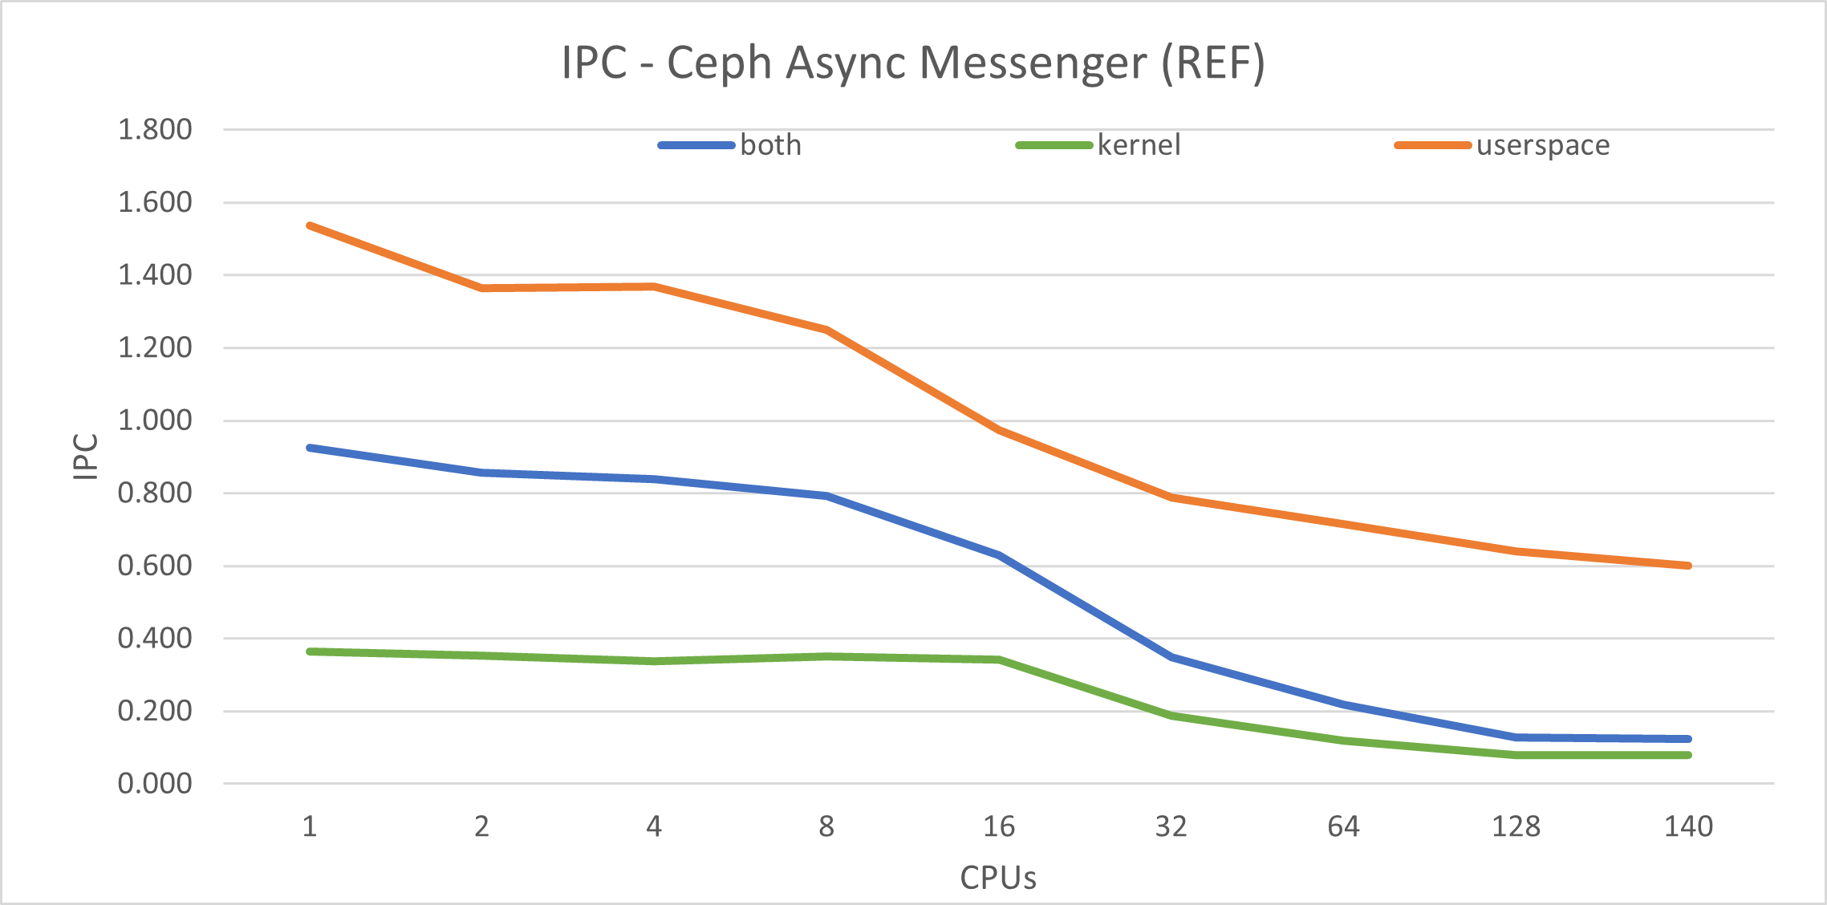
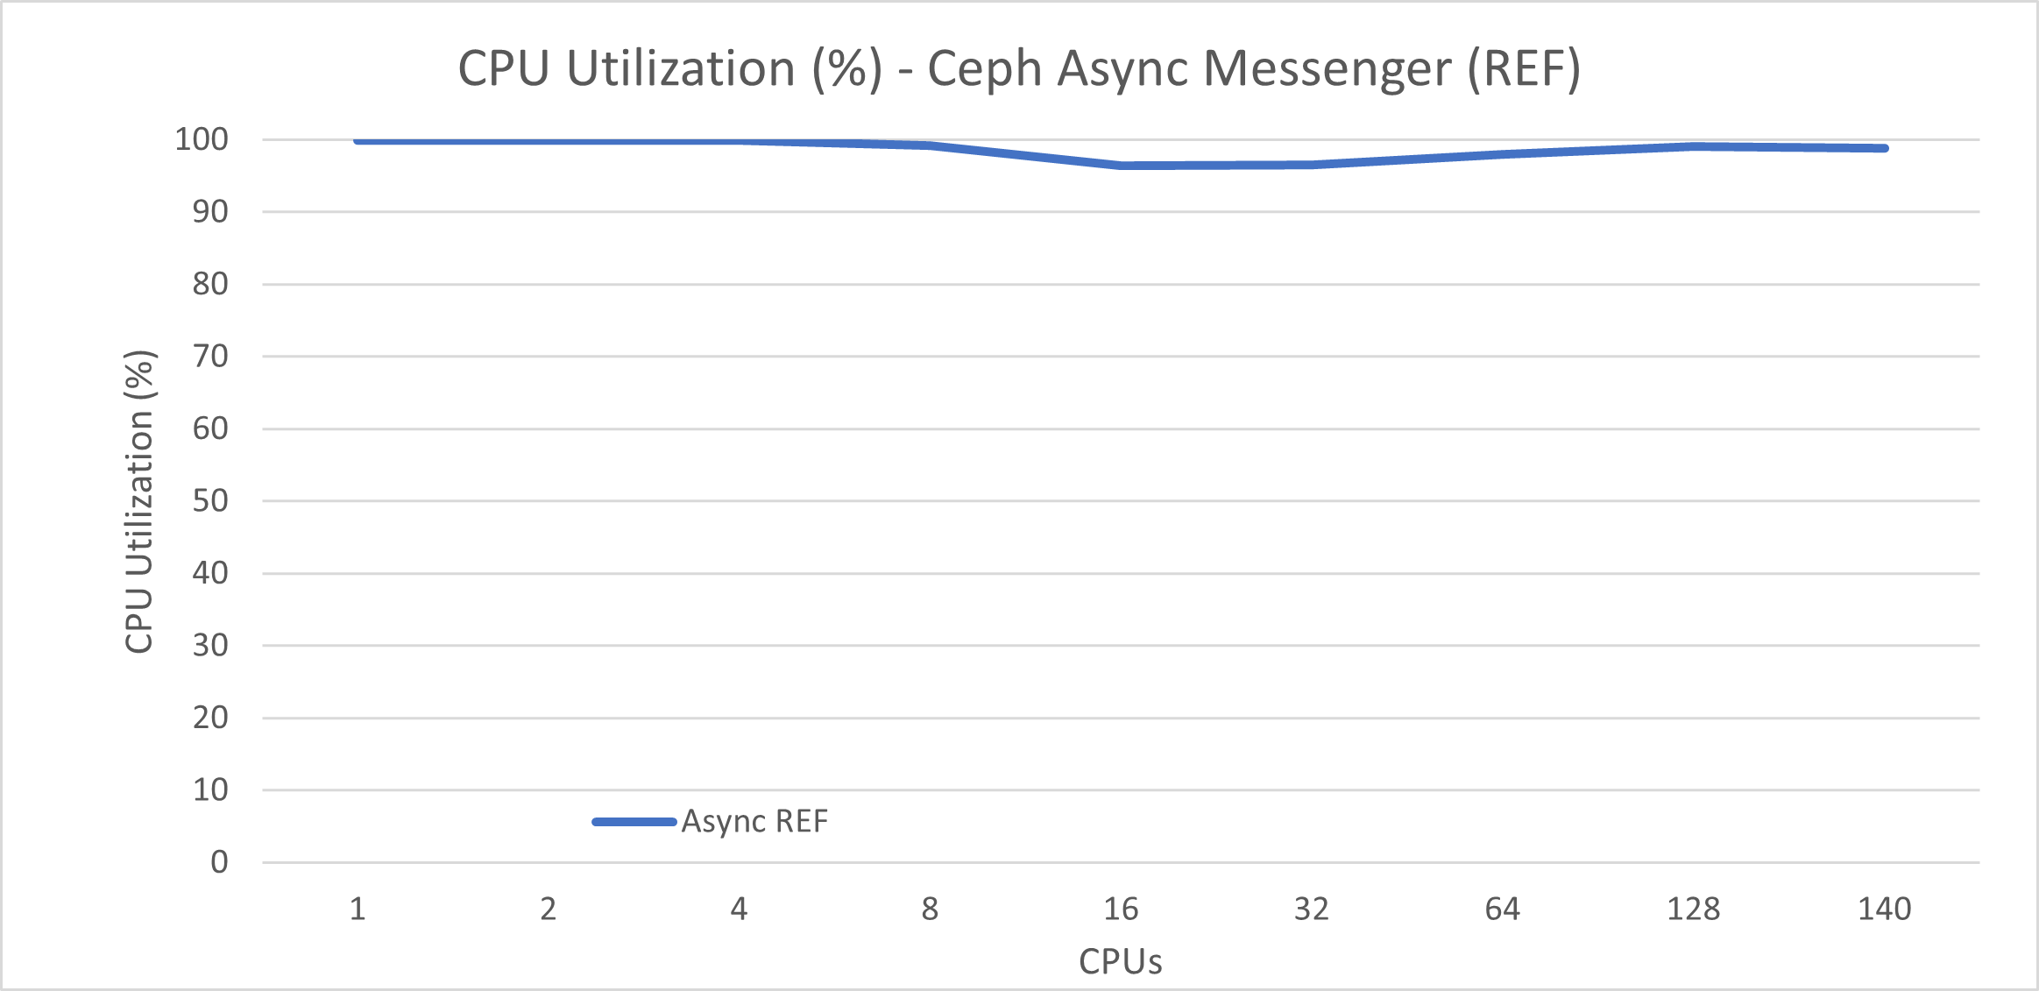
SRF OnePager – Ceph Async Messenger (REF)
IOPS plateau at only 16 CPUs
Cycles were tilted
IPC kept dropping

Slide 4
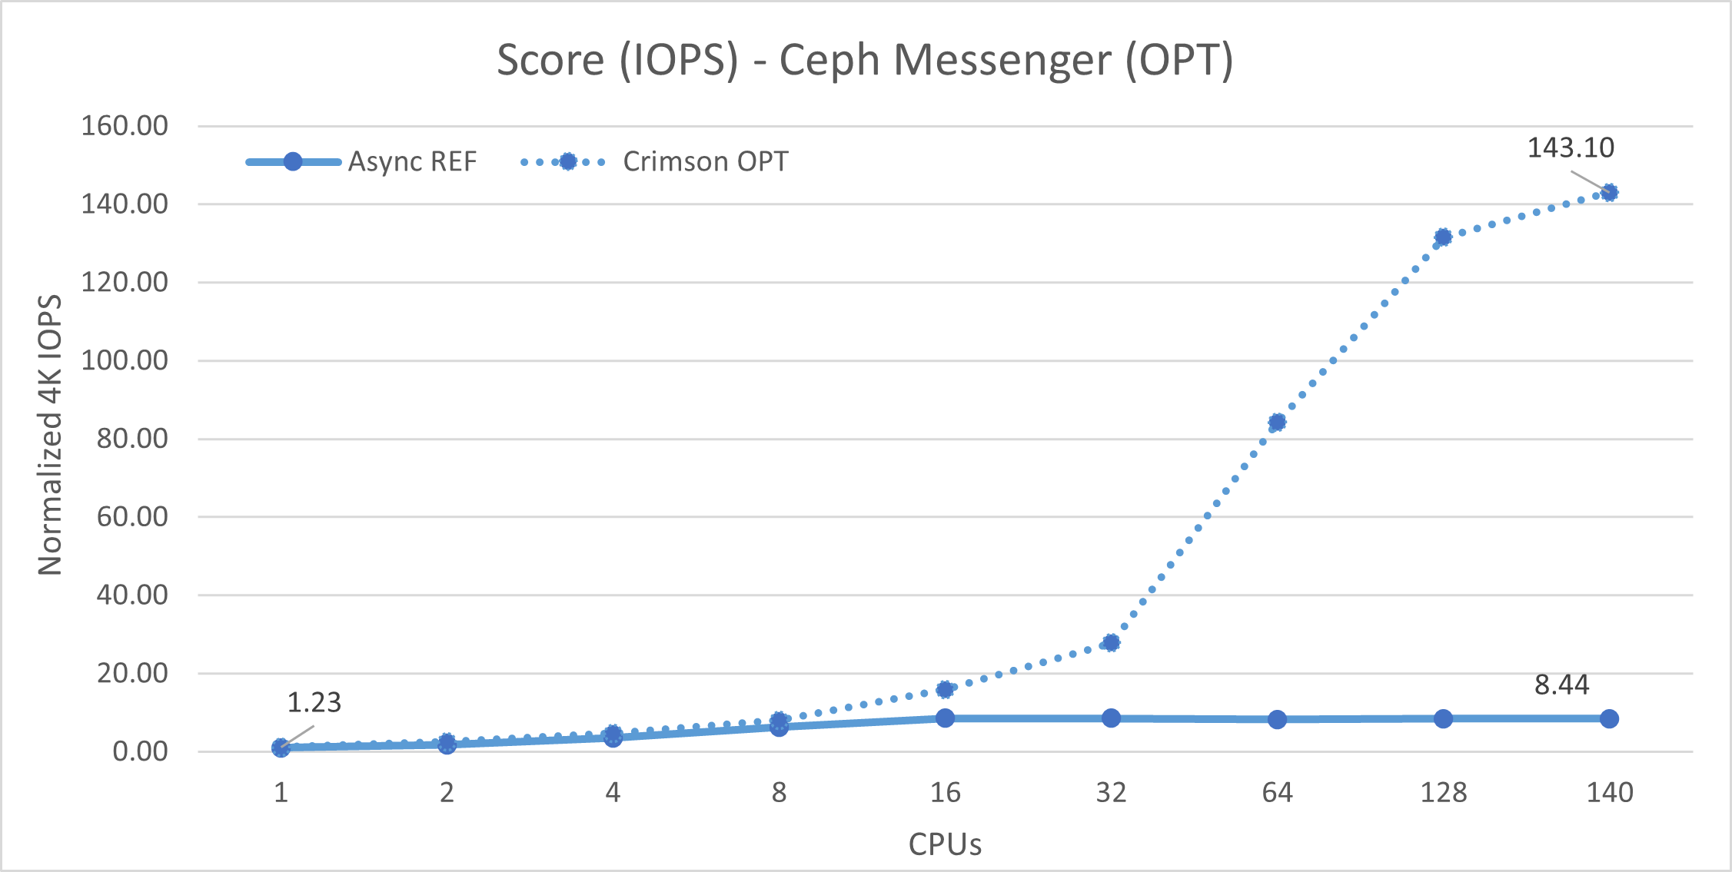
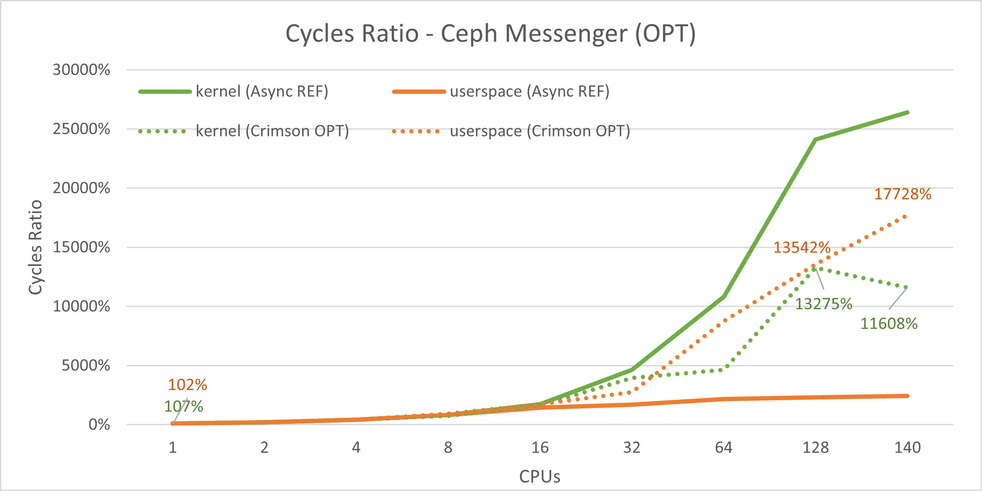
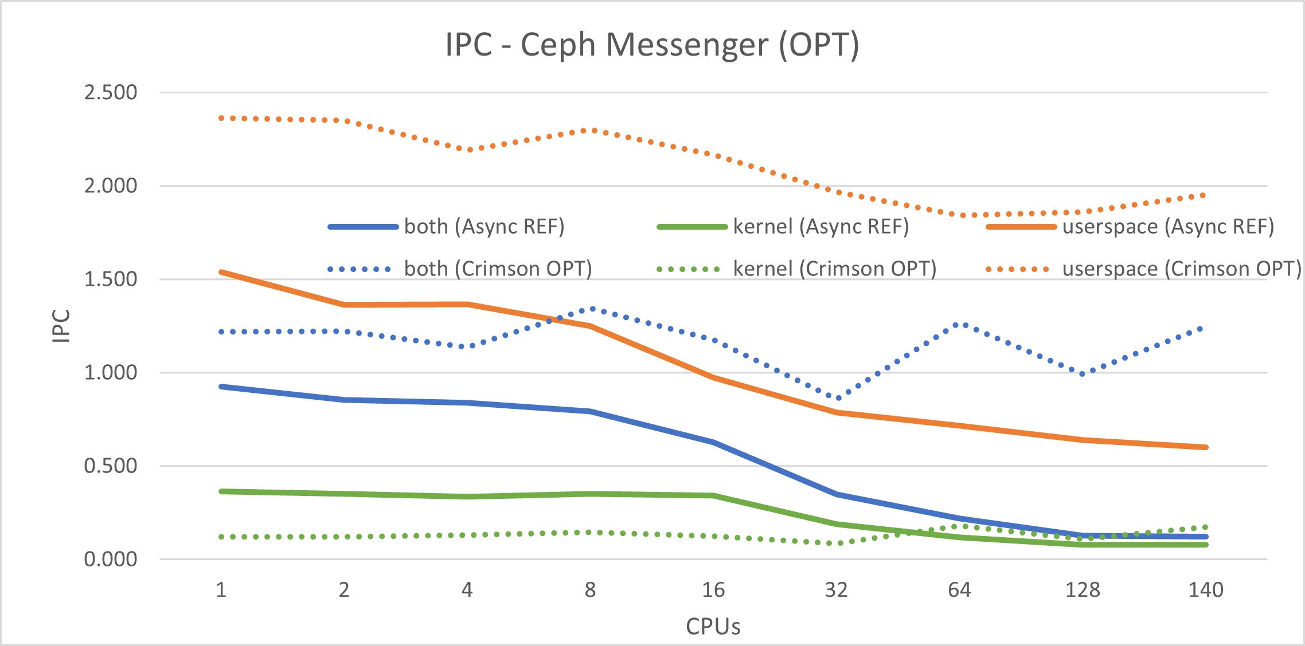
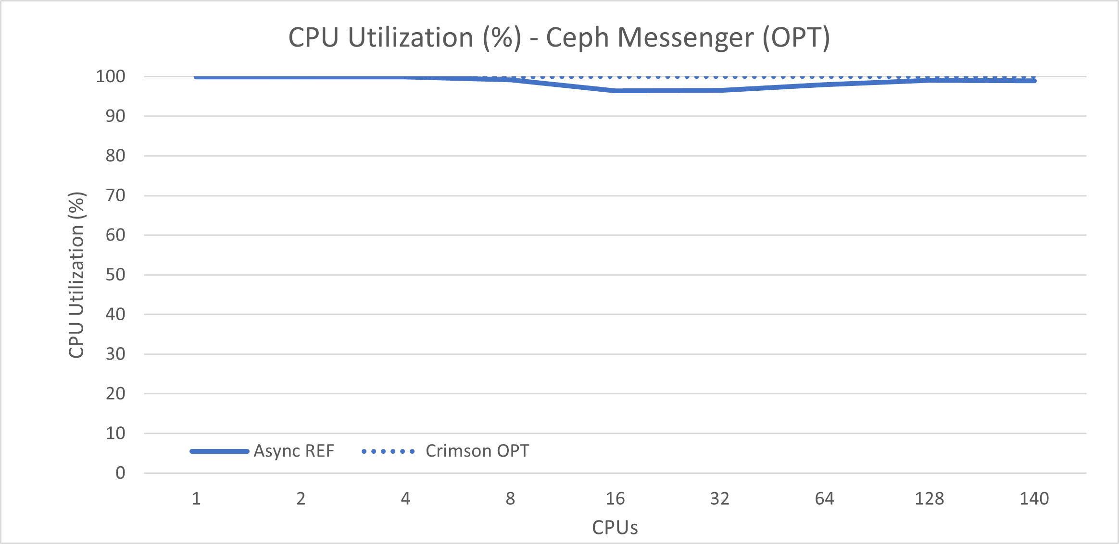
SRF OnePager – Ceph Crimson Messenger (OPT)
IOPS ~17x better
Cycles almost linear
IPC wasn’t dropping
*The absolute numbers might change due to the improved hardware recipe.

Slide 5
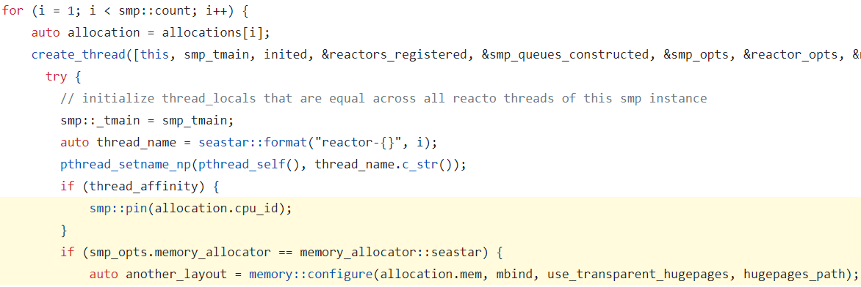
Design choices Async vs Crimson
 | Async | Crimson
Threading model | Threads running in arbitrary cores | One-thread-per-core
Resource managements | Shared among threads | Shared-nothing (sharded by core)
Task affinity | Thread pool with task queues | Run-to-completion (in the same core)
Property 1: task scheduling | Preemptive, kernel-space | Cooperative, user-space
Property 2: locks ? | Yes | No
Property 3: thread migration | Frequent | Infrequent
Property 4: memory allocator | Standard (glibc/jemalloc/tcmalloc) | Specialized: NUMA-aware, lockless, hugepage
Implementations
Async messenger: https://github.com/ceph/ceph/tree/main/src/msg/async
Crimson messenger: https://github.com/ceph/ceph/tree/main/src/crimson (mostly upstream by Intel)

Slide 6
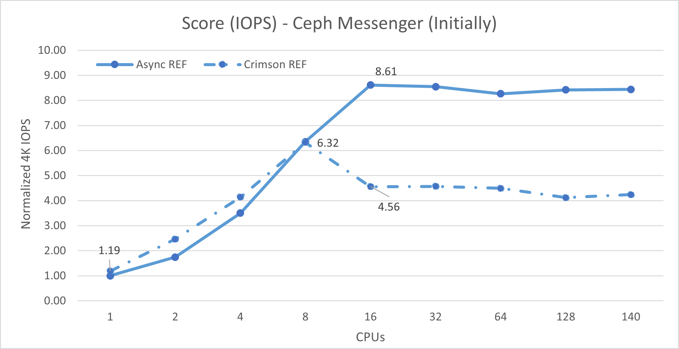
However, the devil is still in the details – Initial results
Crimson is 53% slower

Slide 7
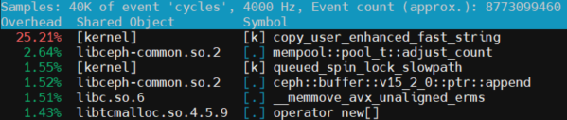
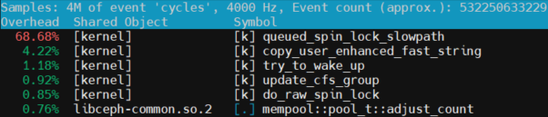
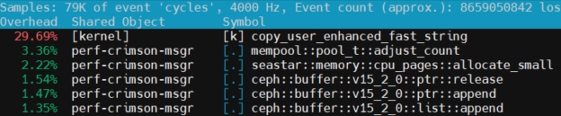
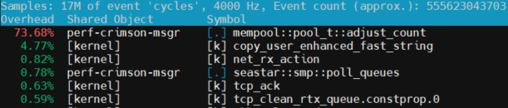
Hotspot analysis (1 vs 64 cores, Async vs Crimson)
Async: 1 core
64 cores
Crimson: 1 core
64 cores
From 1 to 64 cores, hotspot moved from copy_user_enhanced_fast_string to:
Async Messenger: queued_spin_lock_slowpath(), lock!
Crimson Messenger: mempool::pool_t::adjust_count(), however, no lock was observed
mempool::pool_t::adjust_count() was also present in Async, implying it is the code from shared infrastructure, and only intensified in Crimson

Slide 8
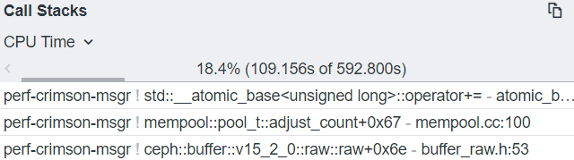
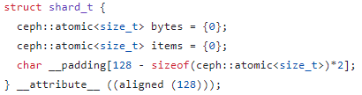
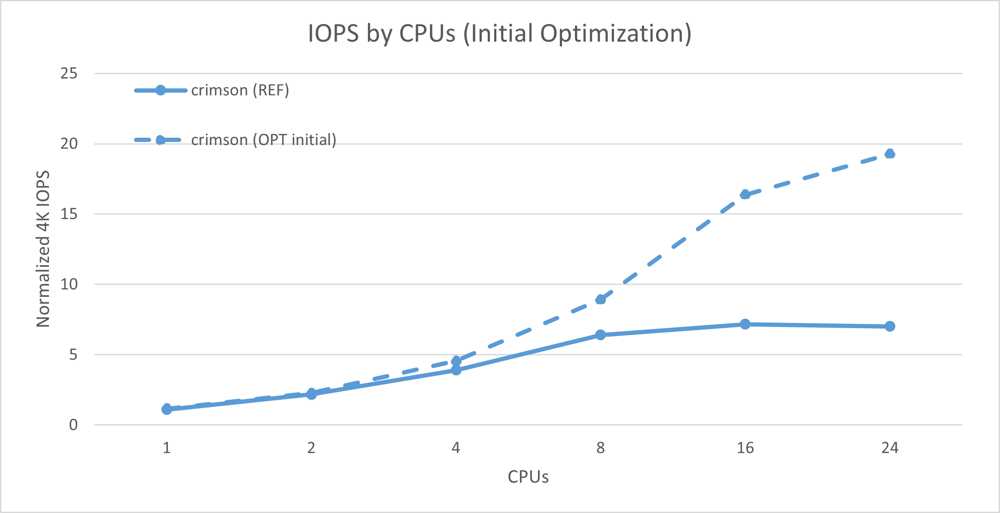
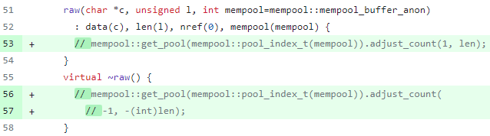
The Initial Optimization and Results
https://github.com/ceph/ceph/pull/52404:
(Issue was in ceph::buffer::raw)
IOPS ~2.7x better

Slide 9
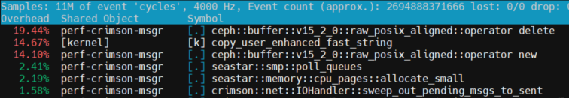
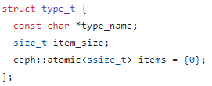
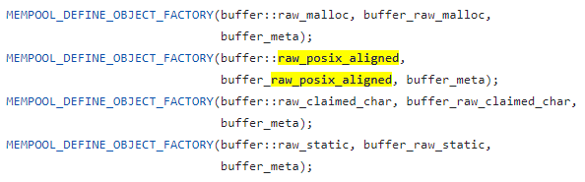
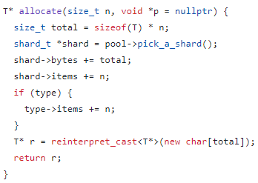
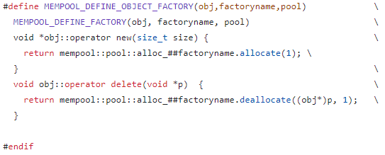
Hotspot analysis after the initial optimization
Crimson Messenger (64 cores)
(again)

Slide 10
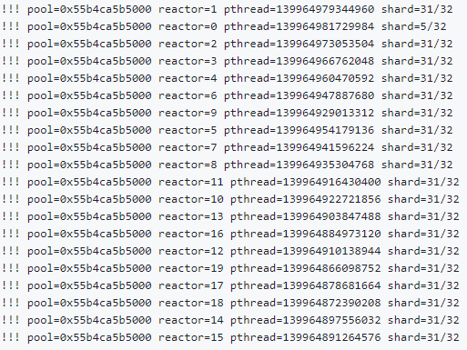
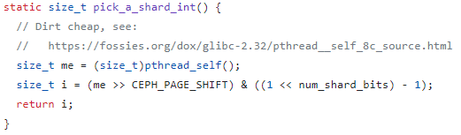
The Ongoing Optimization (root cause)
Identified issues:
type_t::items was accessed by all the threads simultaneously
shard_t looked to be sharded by threads, but:
Collisions!

Slide 11
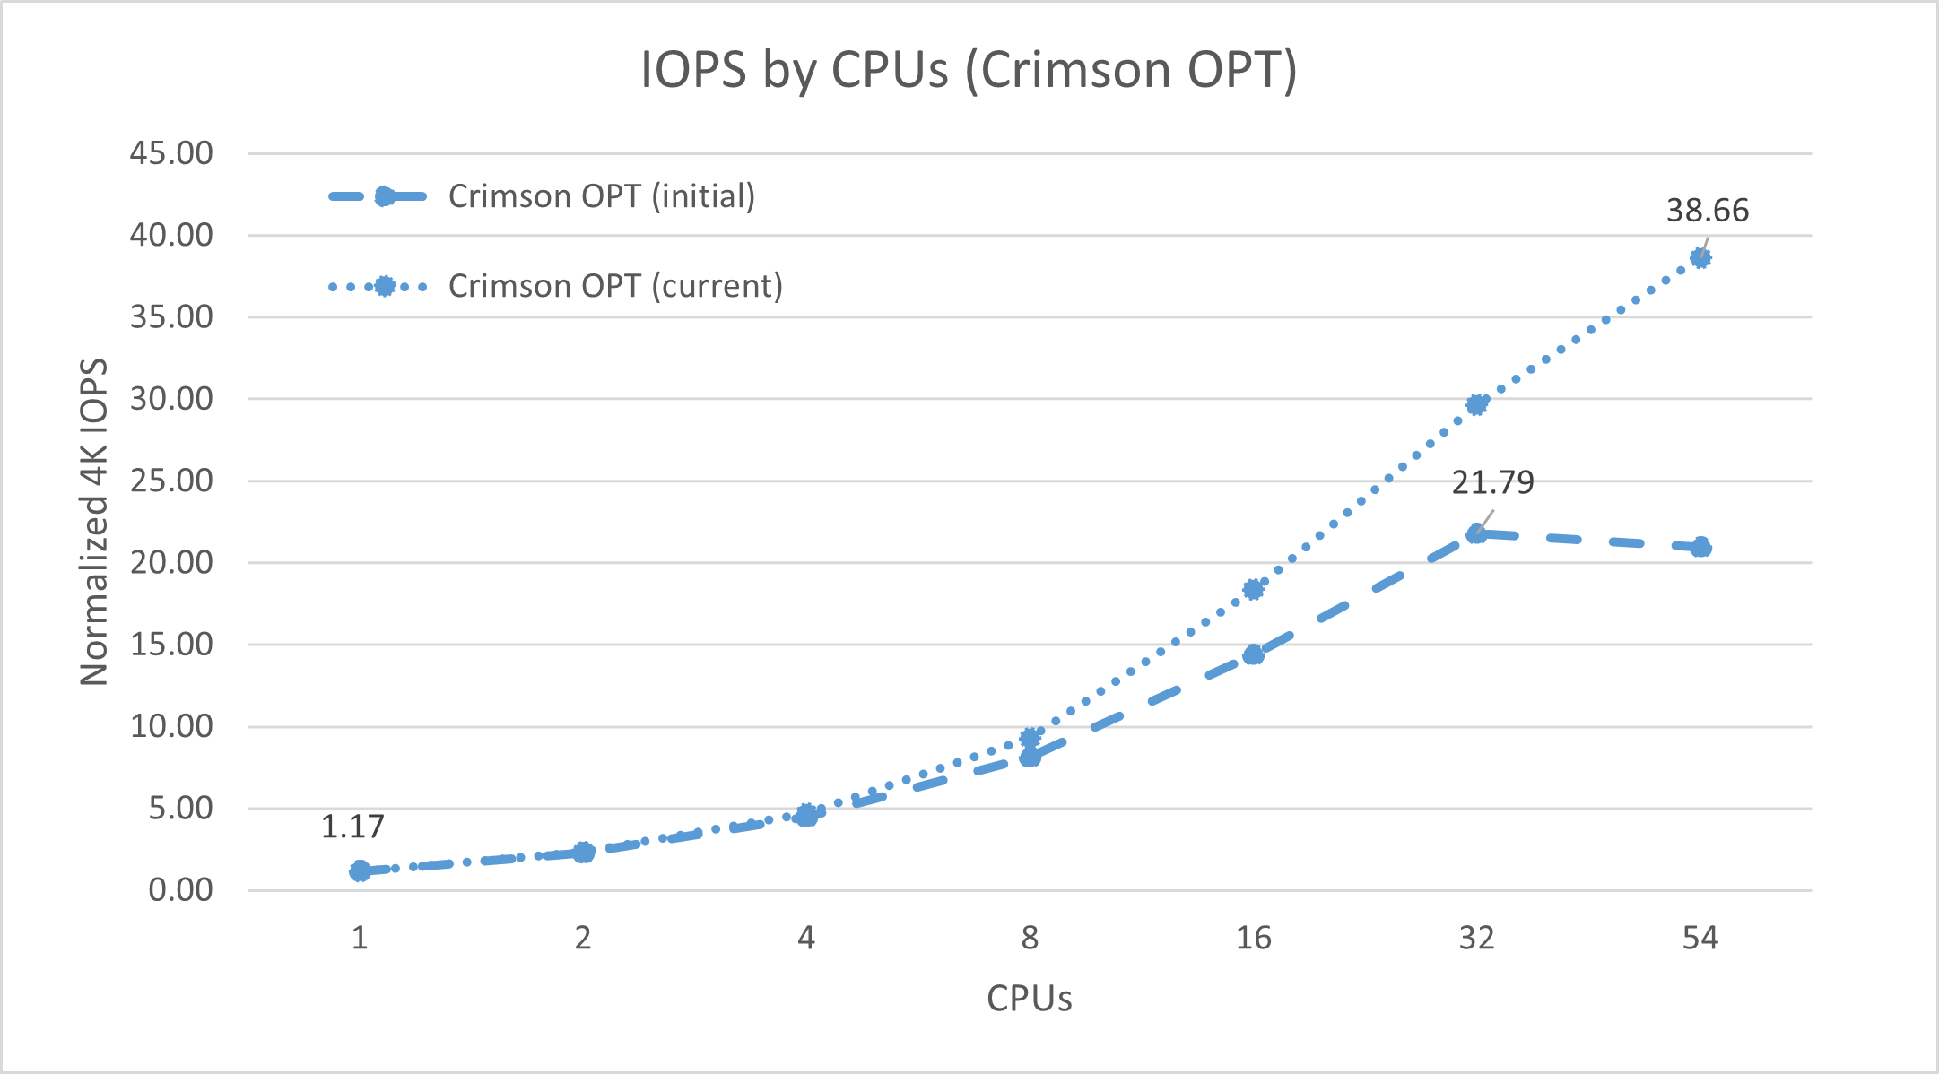
The Ongoing Optimization (results)
https://github.com/ceph/ceph/pull/53130
type_t::items to become sharded
change pthread_self() to sched_getcpu()
IOPS ~1.8x better

Slide 12
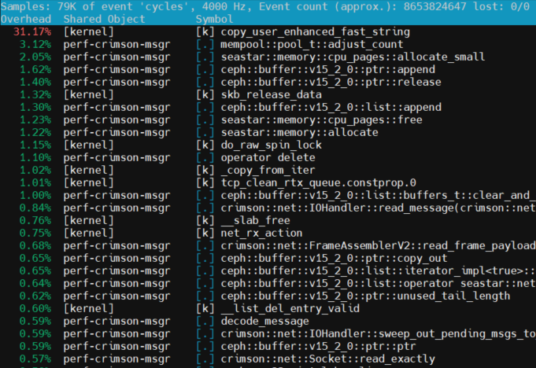
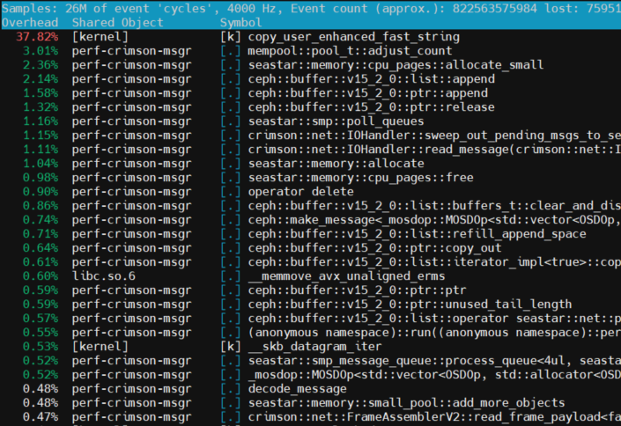
Crimson design goal is proved to be achieved
Crimson Messenger hotspot pattern was consistent from 1 to 140 cores
Each thread worked independently in the I/O path due to the shared-nothing design
1 core
140 cores

Slide 13
Key Takeaways
Shared-nothing, run-to-completion, one-thread-per-core models can essentially address the performance issue about core scalability.
The ideal performance-core-scaling property is challenging to be achieved.
Software redesign can contribute to performance greatly; however, the decision should be discreet due to the potential efforts.

Slide 14
How to benchmark, apple-to-apple
Messenger V2 Protocol: https://docs.ceph.com/en/latest/rados/configuration/msgr2/
Async Messenger (REF):
As test server: https://github.com/ceph/ceph/blob/main/src/crimson/tools/perf_async_msgr.cc
1~140 cores, threads = cores * 1.5
Crimson Messenger (OPT):
As test server: https://github.com/ceph/ceph/blob/main/src/crimson/tools/perf_crimson_msgr.cc (server mode)
1~140 cores, one-thread-per-core model (threads = cores)
Test Client:
https://github.com/ceph/ceph/blob/main/src/crimson/tools/perf_crimson_msgr.cc (client mode)
Running in another CPU socket; Client cores >= Server cores
Client connections = Client cores * 2; IO depth = 512 per connection; Roundtrip
4K payload; Ramp up 5 seconds; Run 10 seconds
Metric: IO per second (throughput)

Slide 15
Next steps
Keep refining Ceph infrastructure implementations to be crimson compatible.
Work with Ceph Community on Crimson OSD logic.
SeaStore: the storage engine for Crimson OSD.

Slide 16
More resources
Ceph Blog: https://ceph.com/en/news/blog/2023/crimson-multi-core-scalability/
Project documentation: https://docs.ceph.com/en/latest/dev/crimson/
Introduction: https://www.youtube.com/watch?v=vc5w2mn93cY
Crimson codebase: https://github.com/ceph/ceph/tree/master/src/crimson
Discussions: https://pad.ceph.com/p/crimson-weekly-meeting
Pull requests: https://github.com/issues?q=is%3Apr+label%3Acrimson

Slide 17
Q & A

